Slide 1
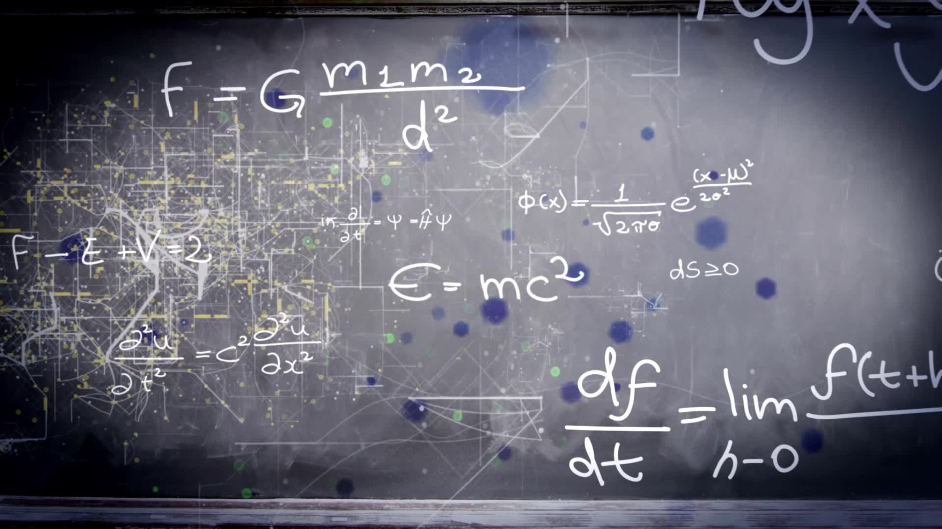
Research on renewable resources
By Felix and Ismael

Slide 2
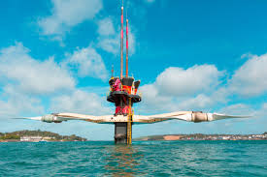
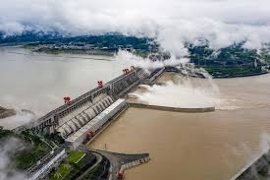
Hydro electricity
Next: Tidal Energy
Pros:
Renewable energy source.
Can meet peak electricity demands.
Pairs well with other renewables.
It is an inexpensive source of energy In the long run.
Cons:
Expensive up front.
There are a lack of available reservoirs.
There are some environmental impacts.
Facilities rely on local hydrology. (water properties)

Slide 3
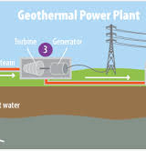
Tidal
Next: Geothermal
Cons:
Initial construction cost is very high.
Formation of silt behind the barrage.
Effect on animals and plants living near tidal stations
Very few suitable sites for constructing barrages.
Disturbs migration of living creatures in the ocean.
Pros:
Clean.
Renewable .
Sustainable resource.

Slide 4
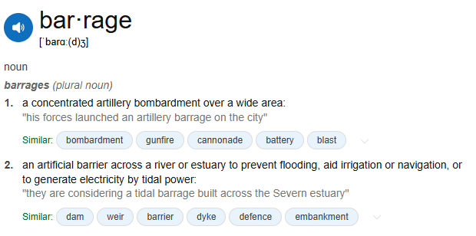


Tidal
Next: Geothermal
Cons:
Initial construction cost is very high.
Formation of silt behind the barrage.
Effect on animals and plants living near tidal stations
Very few suitable sites for constructing barrages.
Disturbs migration of living creatures in the ocean.
Pros:
Clean.
Renewable .
Sustainable resource.

Slide 5
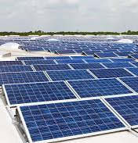
Geothermal
Next: Solar Energy
Pros:
Reliable source of energy.
small land footprint.
usable for small and large-scale installation.
Cons:
location dependent.
high initial costs.
can lead to surface instability.

Slide 6
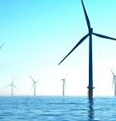
Solar
Next: Wind Turbine
Pros:
Almost zero maintenance.
Energy independence.
Can improve property value.
Excellent return on investment.
Cons:
High up front cost.
Can put buyers off.
Uses a lot of roof space.
Not all roof configurations are suitable

Slide 7
Wind turbines
Pros:
Clean, sustainable and abundant.
Cost-effective.
Price continues to drop.
Turbines are an efficient use of land.
Cons:
Variable energy source (needs wind to work).
Turbines can be loud. ~45dB on average
Construction can cause local disturbances.
Not the most aesthetically pleasing. (weird big fidget spinner)

Slide 8
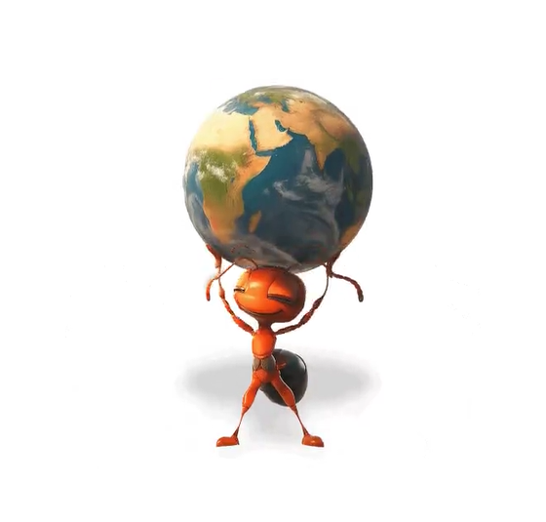
We hope you liked the presentation
Make sure you stay warm and wrap up in this cold climate
zachu, jsi kobliha a přeji hezké vánoce (for zach)
Certifique-se de se manter aquecido e agasalhado neste clima frio. (for ismael)
Asegúrate de mantenerte abrigado y abrigado en este clima frío. (for mr roberts)

